Slide 1
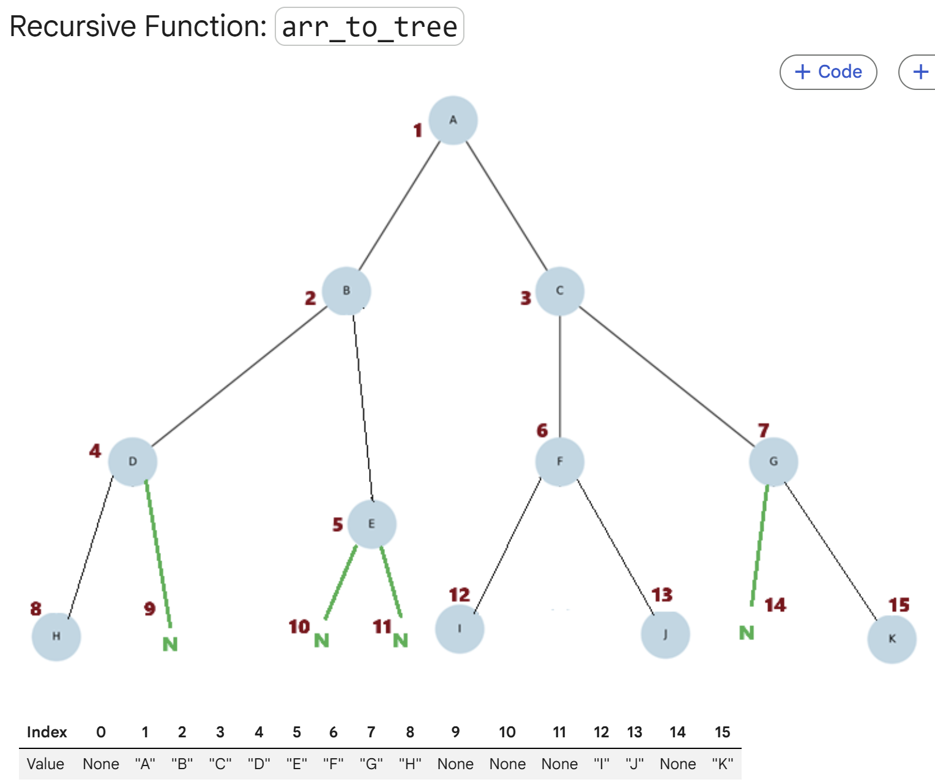
Binary Tree Implementation in Java
Array representation, driver code, array-to-tree conversion, traversal, level, height, and size
CSE220 | Binary Tree Java Lecture

Slide 2
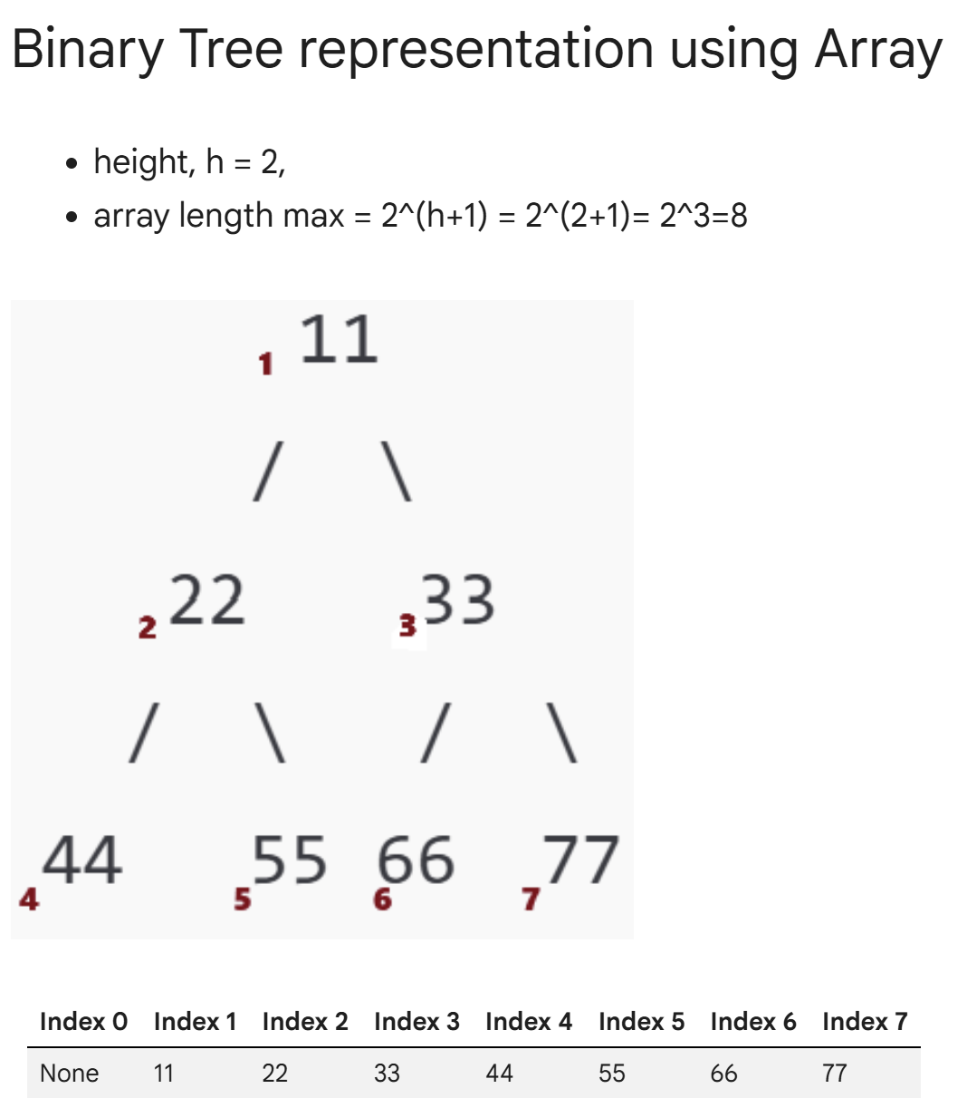
Binary Tree Representation Using Array
Key rules:
• Root is stored at index 1.
• Index 0 is unused.
• For a node at index i:
left child = 2i, right child = 2i + 1.
• For height h, maximum array length = 2^(h+1).
class Tree {
Object[] tree;
public Tree(Object root, int length) {
// Index 0 is unused; 1-based indexing
tree = new Object[length];
tree[1] = root; // root at index 1
}
public void setChild(int parentIndex,
String side,
Object child) {
int childIndex;
if (side.equals("left")) {
childIndex = parentIndex * 2;
} else if (side.equals("right")) {
childIndex = parentIndex * 2 + 1;
} else {
return;
}
tree[childIndex] = child;
}
}
CSE220 | Binary Tree Java Implementation

Slide 3
Driver Code for Array Representation
The driver creates the tree, inserts children using the 2i / 2i+1 rule, and prints the final array representation.
// Driver code
public static void main(String[] args) {
Tree tree = new Tree(11, 8); // 0 to 7
// Set children for each node
tree.setChild(1, "left", 22);
tree.setChild(1, "right", 33);
tree.setChild(2, "left", 44);
tree.setChild(2, "right", 55);
tree.setChild(3, "left", 66);
tree.setChild(3, "right", 77);
// Print the tree array
tree.printTreeArray();
}
// Output: - 11 22 33 44 55 66 77
CSE220 | Binary Tree Java Implementation

Slide 4
Printing the Tree Array
The method scans the whole array. Actual values are printed normally; null positions are printed as "-" to show empty locations.
public void printTreeArray() {
for (int i = 0; i < tree.length; i++) {
if (tree[i] != null) {
System.out.print(tree[i] + " ");
} else {
System.out.print("- ");
}
}
System.out.println();
}
CSE220 | Binary Tree Java Implementation

Slide 5
Recursive Function: arrToTree()
Purpose: convert the array representation into linked nodes. Each recursive call creates one node and then builds its left and right subtrees.
class TNode {
String val;
TNode left, right;
TNode(String val) {
this.val = val;
}
}
public static TNode arrToTree(String[] arr, int i) {
// Base case
if (i >= arr.length || arr[i] == null) {
return null;
}
// Recursive case
TNode root = new TNode(arr[i]);
root.left = arrToTree(arr, 2 * i);
root.right = arrToTree(arr, 2 * i + 1);
return root;
}
CSE220 | Binary Tree Java Implementation

Slide 6
Binary Tree Traversal
Traversal means visiting all nodes in a specific order. The position of the root determines the traversal type.
// Preorder: Root, Left, Right
public static void printPreOrder(TNode root) {
if (root == null) return;
System.out.print(root.val + " ");
printPreOrder(root.left);
printPreOrder(root.right);
}
// Inorder: Left, Root, Right
public static void printInOrder(TNode root) {
if (root == null) return;
printInOrder(root.left);
System.out.print(root.val + " ");
printInOrder(root.right);
}
// Postorder: Left, Right, Root
public static void printPostOrder(TNode root) {
if (root == null) return;
printPostOrder(root.left);
printPostOrder(root.right);
System.out.print(root.val + " ");
}
CSE220 | Binary Tree Java Implementation

Slide 7
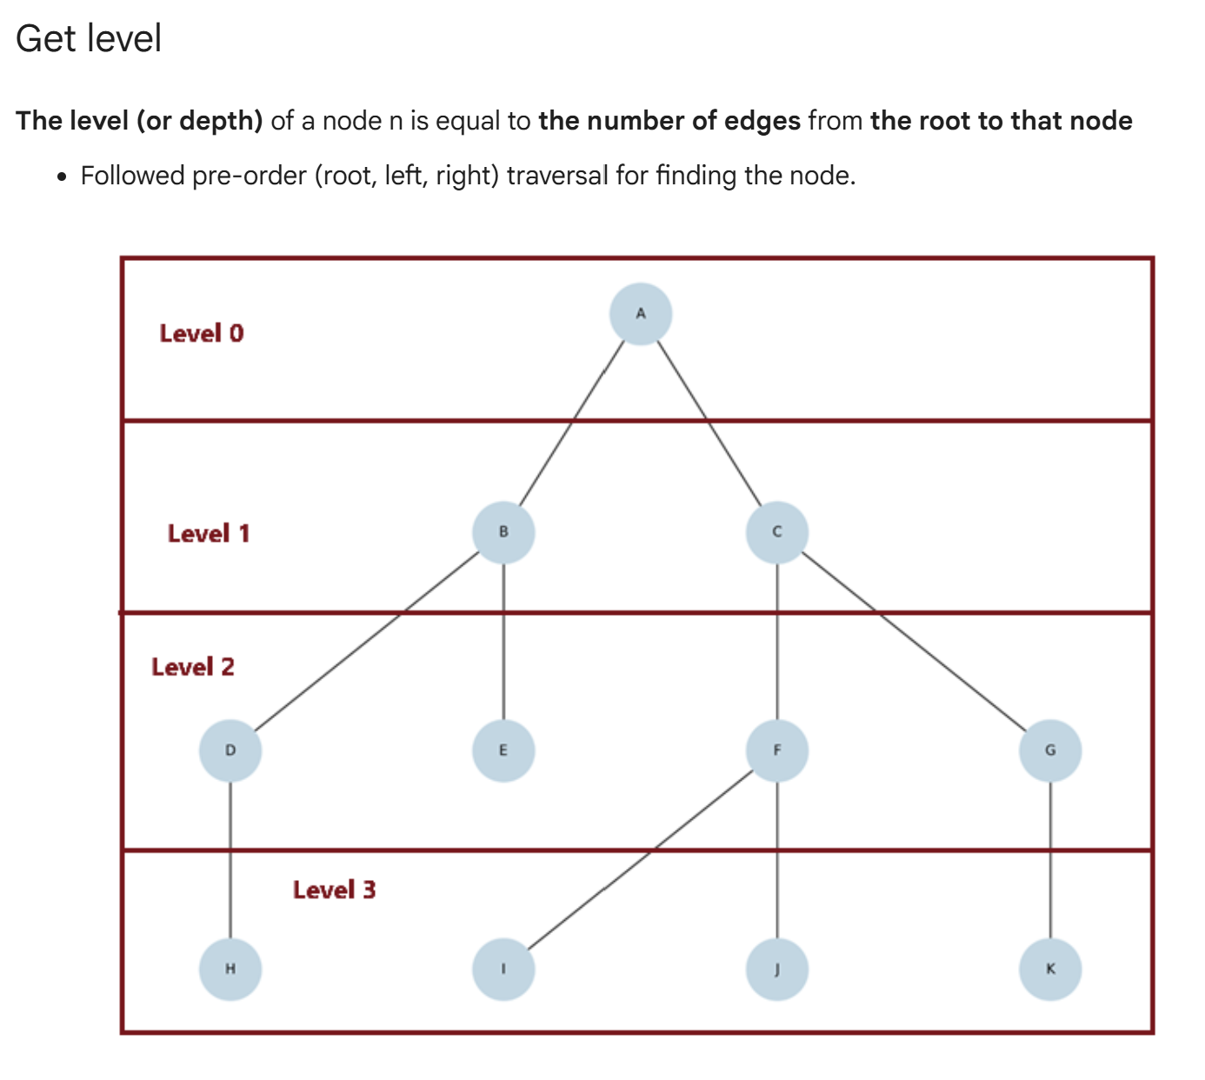
Get Level of a Node
Level/depth = number of edges from the root to the node. Start with level 0 at the root and increase by 1 in each recursive call.
public static int getLevel(TNode root,
String value,
int level) {
if (root == null) return -1;
if (root.val.equals(value)) {
return level;
}
int leftLevel = getLevel(root.left,
value,
level + 1);
int rightLevel = getLevel(root.right,
value,
level + 1);
return Math.max(leftLevel, rightLevel);
}
CSE220 | Binary Tree Java Implementation

Slide 8
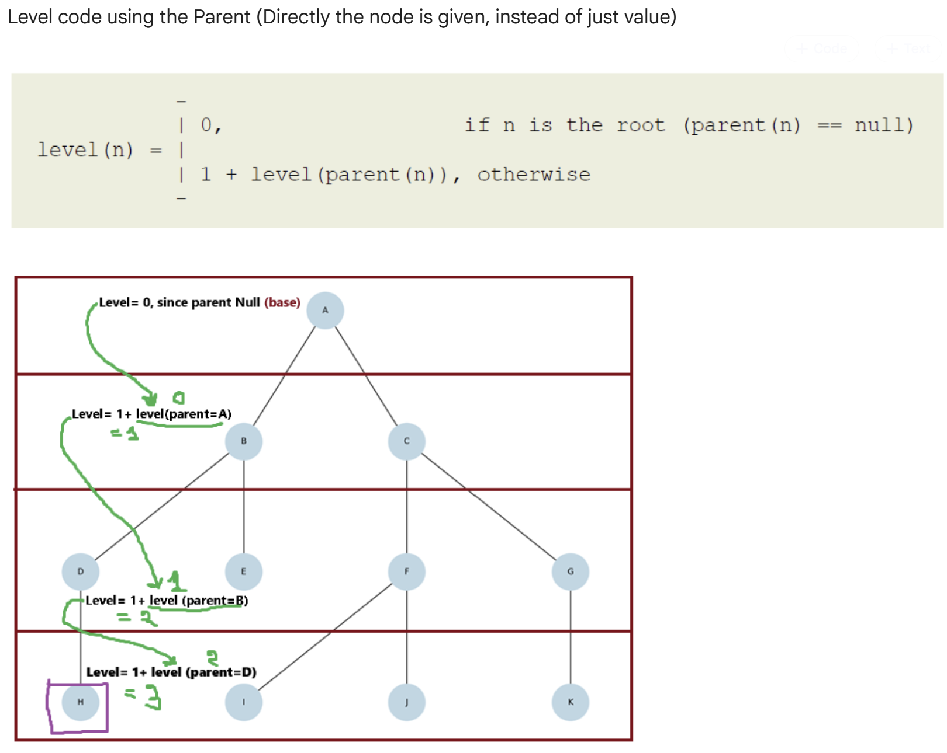
Get Level Using Parent Pointer
level(n) = 0, if n is the root
level(n) = 1 + level(parent(n)), otherwise
class TPNode {
String val;
TPNode left, right, parent;
TPNode(String val, TPNode parent) {
this.val = val;
this.parent = parent;
}
}
public static int getLevelWithParent(TPNode node) {
if (node == null) return -1;
if (node.parent == null) return 0;
return 1 + getLevelWithParent(node.parent);
}
CSE220 | Binary Tree Java Implementation

Slide 9
Find Node Before Computing Parent-Based Level
If only the target value is known, first find the node. Then compute its level by using the parent pointer.
public static TPNode findNode(TPNode root,
String target) {
if (root == null) return null;
if (root.val.equals(target)) return root;
TPNode left = findNode(root.left, target);
if (left != null) return left;
return findNode(root.right, target);
}
// Usage
TPNode node = findNode(root, "H");
int level = getLevelWithParent(node);
CSE220 | Binary Tree Java Implementation

Slide 10
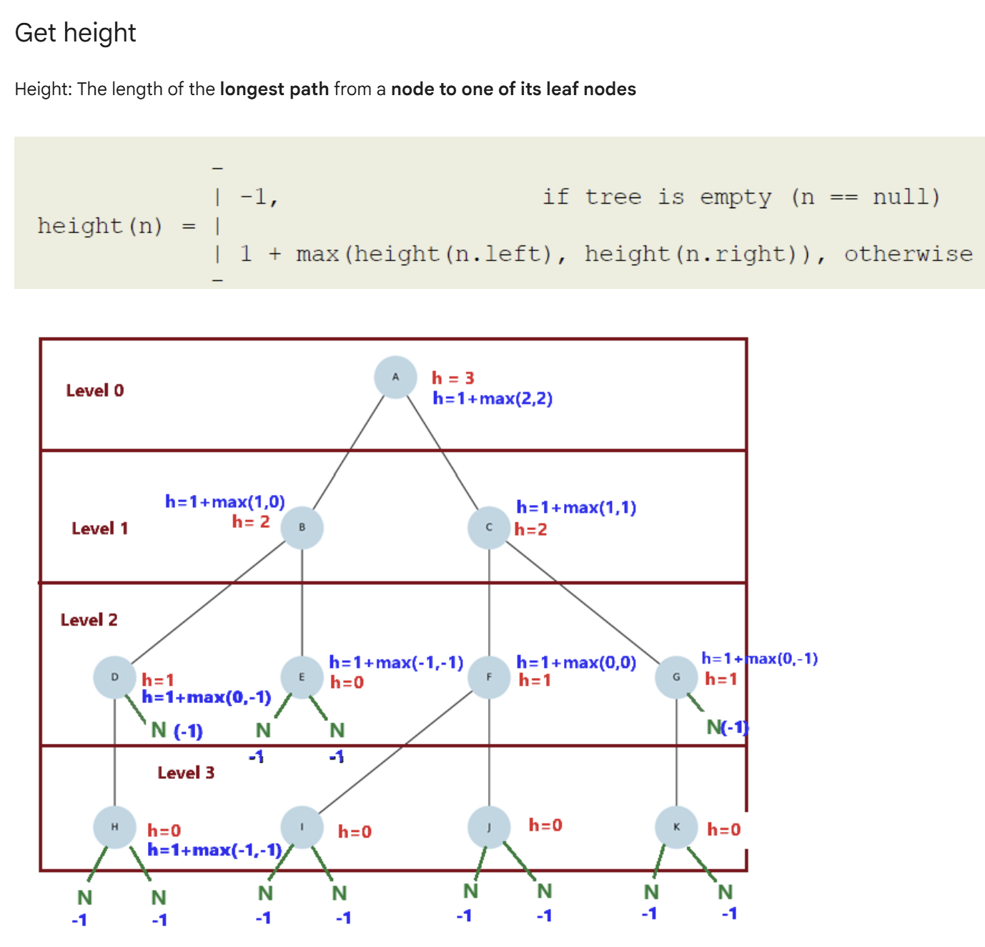
Get Height of a Node
Height = length of the longest path from a node to one of its leaf nodes. Empty subtree height is -1; therefore, a leaf node has height 0.
public static int getHeight(TNode node) {
if (node == null) {
return -1;
}
int leftHeight = getHeight(node.left);
int rightHeight = getHeight(node.right);
return 1 + Math.max(leftHeight,
rightHeight);
}
// Example:
// Height of A = 3
// Height of B = 2
// Height of F = 1
// Height of leaf = 0
CSE220 | Binary Tree Java Implementation

Slide 11
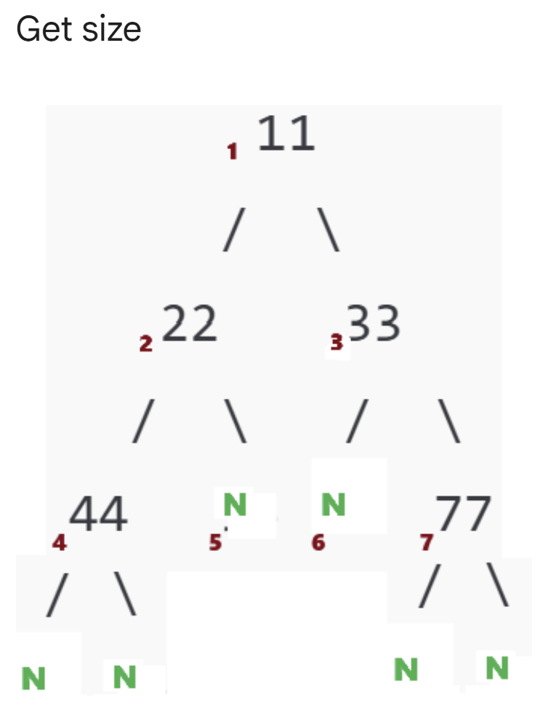
Get Size of a Binary Tree
Size = total number of actual nodes in the tree. Null links are not counted as nodes.
public static int getSize(TNode node) {
if (node == null) {
return 0;
}
return 1
+ getSize(node.left)
+ getSize(node.right);
}
// Meaning:
// current node + left subtree size
// + right subtree size
CSE220 | Binary Tree Java Implementation

Slide 12
Binary Tree Java Methods: Summary
• Array representation: root at index 1; left = 2i; right = 2i + 1.
• Driver code: builds the tree by assigning children to parent indices.
• arrToTree(): recursively converts array entries into linked nodes.
• Traversal: preorder, inorder, and postorder.
• Level: number of edges from root to target.
• Height: longest path from node to leaf.
• Size: total number of actual nodes.
Core recursion pattern: check the base case first, then recursively process the left and right subtrees.
CSE220 | Binary Tree Java Implementation

